Slide 1

Transfer Learning for Deep Learning: TensorFlow & ML .NET
Luis Beltrán

Slide 2

I´m Mexican, currently living in Czech Republic.
I´m a researcher and student at Tomas Bata University in Zlín
I´m a Microsoft MVP in AI and Developer Technologies.
I enjoy developing mobile apps, working with cloud technology and implementing AI-driven solutions
Luis Beltrán
luis@luisbeltran.mx
@darkicebeam

Slide 3
In the classic supervised learning scenario of machine learning, if we intend to train a model for some task and domain A, we assume that we are provided with labeled data for the same task and domain.
Notes:
We can see this clearly in Figure 1, where the task and domain of the training and test data of our model A is the same.
A task is the objective our model aims to perform, e.g. recognize objects in images, and a domain is where our data is coming from, e.g. images found in coffee shops.
We can now train a model A on this dataset and expect it to perform well on unseen data of the same task and domain.
When given data for some other task or domain B, we require again labeled data of the same task or domain that we can use to train a new model B so that we can expect it to perform well on this data.
Supervised learning paradigm breaks when we do not have sufficient labeled data for the task or domain we care about to train a reliable model.
If we want to train a model to perform a new task, such as detecting bicyclists, we cannot even reuse an existing model, as the labels between the tasks differ.

Slide 4
Training an Image Classification model from scratch requires setting millions of parameters, a ton of labeled training data and a vast amount of compute resources (hundreds of GPU hours).
Deep learning models are trained by using enormous sets of labeled data and neural networks that contain multiple learning layers.
Notes:
Deep Learning requires high-end machines contrary to traditional Machine Learning algorithms. GPU has become a integral part now to execute any Deep Learning algorithm.

Slide 5
Transfer Learning
A machine learning method where a model developed for a task is reused as the starting point for a model on a second task.
The process of using knowledge gained while solving a problem and applying it to a different but related problem.
Notes:
It is a popular approach in deep learning where pre-trained models are used as the starting point on computer vision and natural language processing tasks given the vast compute and time resources required to develop neural network models on these problems and from the huge jumps in skill that they provide on related problems.
In other words
Transfer learning is an optimization that allows rapid progress or improved performance when modeling the second task.

Slide 6
Notes:
Traditional learning is isolated and occurs purely based on specific tasks, datasets and training separate isolated models on them. No knowledge is retained which can be transferred from one model to another.
In transfer learning, you can leverage knowledge (features, weights etc) from previously trained models for training newer models and even tackle problems like having less data for the newer task!

Slide 7
How does it work?
You delete what’s known as the “loss output” layer, which is the final layer used to make predictions, and replace it with a new loss output layer for your general prediction.
This loss output layer is a fine-tuning node for determining how training penalizes deviations from the labeled data and the predicted output.
Notes:
In transfer learning, we first train a base network on a base dataset and task,

Slide 8
Next, you would take your smaller dataset for your general labels and train it on the entire N-layer neural network or the last few layers or just the loss layer alone.
By applying these transfer learning techniques, your output on the new CNN will be able to identify general elements.
Notes:
and then we repurpose the learned features, or transfer them, to a second target network to be trained on a target dataset and task.
This process will tend to work if the features are general, meaning suitable to both base and target tasks, instead of specific to the base task.
Transfer learning only works in deep learning if the model features learned from the first task are general.

Slide 9
Pre-Trained Models
To solve a problem, we need to have a pre-trained model of a similar problem. Instead of building a model from scratch to solve a similar problem, we use the model trained on other problem as a starting point.

Slide 10
Notes:
Salient parts in the image can have extremely large variation in size. For instance, an image with a dog can be either of the following, as shown below. The area occupied by the dog is different in each image.
Because of this huge variation in the location of the information, choosing the right kernel size for the convolution operation becomes tough.
A larger kernel is preferred for information that is distributed more globally, and a smaller kernel is preferred for information that is distributed more locally.
Very deep networks are prone to overfitting. It also hard to pass gradient updates through the entire network.
Naively stacking large convolution operations is computationally expensive.

Slide 11
Inception network
Notes:
The Inception network was an important milestone in the development of CNN classifiers.
was complex (heavily engineered). It used a lot of tricks to push performance; both in terms of speed and accuracy. Its constant evolution lead to the creation of several versions of the network.
Inception v1.
Inception v2 and Inception v3.
Inception v4 and Inception-ResNet.
Each version is an iterative improvement over the previous one. Understanding the upgrades can help us to build custom classifiers that are optimized both in speed and accuracy.
The below image is the “naive” inception module.
It performs convolutionon an input, with 3 different sizes of filters (1x1, 3x3, 5x5).
Additionally, max pooling is also performed. The outputs are concatenated and sent to the next inception module.
As stated before, deep neural networks are computationally expensive.
To make it cheaper, the authors limit the number of input channels by adding an extra 1x1 convolution before the 3x3 and 5x5 convolutions.
Though adding an extra operation may seem counterintuitive, 1x1 convolutions are far more cheaper than 5x5 convolutions, and the reduced number of input channels also help.
Do note that however, the 1x1 convolution is introduced after the max pooling layer, rather than before.
Using the dimension reduced inception module, a neural network architecture was built. This was popularly known as GoogLeNet (Inception v1).

Slide 12
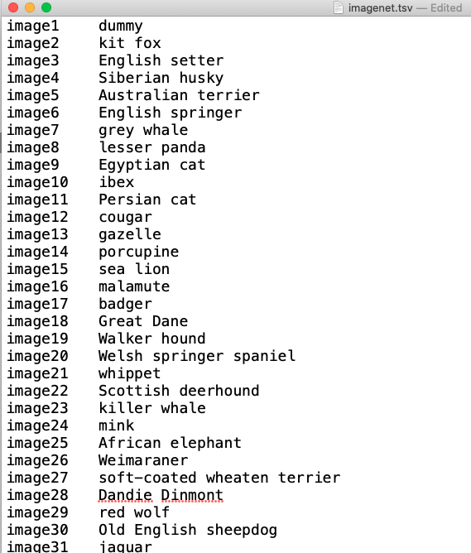

Slide 13
Food
Toy
Appliance
Notes:
Because the Inception model has already been pre trained on thousands of different images, internally it contains the image features needed for image identification.
We can make use of these internal image features in the model to train a new model with far fewer classes.
Enter the transfer part of transfer learning.
You can transfer the Inception model's ability to recognize and classify images to the new limited categories of your custom image classifier.
Food
Toy
Appliance

Slide 14
Transfer Learning in ML .NET

Slide 15
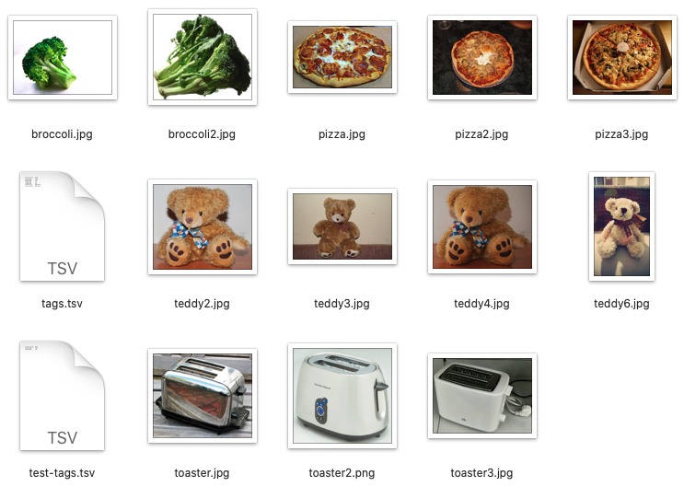
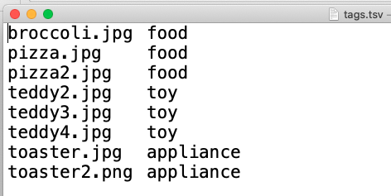
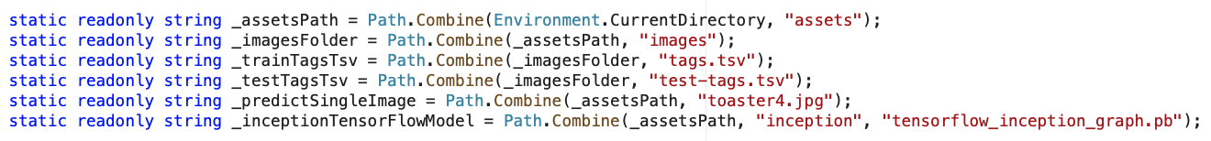
Our data

Slide 16
Input Data Model
public class ImageData
{
[LoadColumn(0)]
public string ImagePath;
[LoadColumn(1)]
public string Label;
}
Notes:
ImageData is the input image data class and has the following String fields:
ImagePath contains the image file name.
Label contains a value for the image label.

Slide 17
Image Prediction Model
public class ImagePrediction : ImageData
{
public float[] Score;
public string PredictedLabelValue;
}
Notes:
ImagePrediction is the image prediction class and has the following fields:
Score contains the confidence percentage for a given image classification.
PredictedLabelValue contains a value for the predicted image classification label.
ImagePrediction is the class used for prediction after the model has been trained. It has a string(ImagePath) for the image path. The Label is used to reuse and train the model. The PredictedLabelValue is used during prediction and evaluation.
For evaluation, an input with training data, the predicted values, and the model are used.

Slide 18
Inception Settings
private struct InceptionSettings
{
public const int ImageHeight = 224;
public const int ImageWidth = 224;
public const float Mean = 117;
public const float Scale = 1;
public const bool ChannelsLast = true;
}

Slide 19
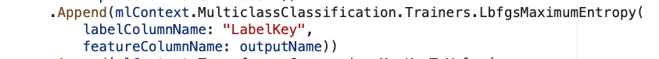
Multiclass Classification
A supervised machine learning task that is used to predict the class (category) of an instance of data.
Inputs:
Label column (key)
Feature column (single)
You can train a multiclass classification model using the following training algorithms:
LightGbmMulticlassTrainer
SdcaMaximumEntropyMulticlassTrainer
SdcaNonCalibratedMulticlassTrainer
LbfgsMaximumEntropyMulticlassTrainer
NaiveBayesMulticlassTrainer
OneVersusAllTrainer
PairwiseCouplingTrainer
ImageClassificationTrainer
Outputs:
Score (Vector of single)
PredictedLabel (key)
Notes:
The specific trainer used in this case is the multinomial logistic regression algorithm.
The algorithm implemented by this trainer performs well on problems with a large number of features, which is the case for a deep learning model operating on image data.

Slide 20
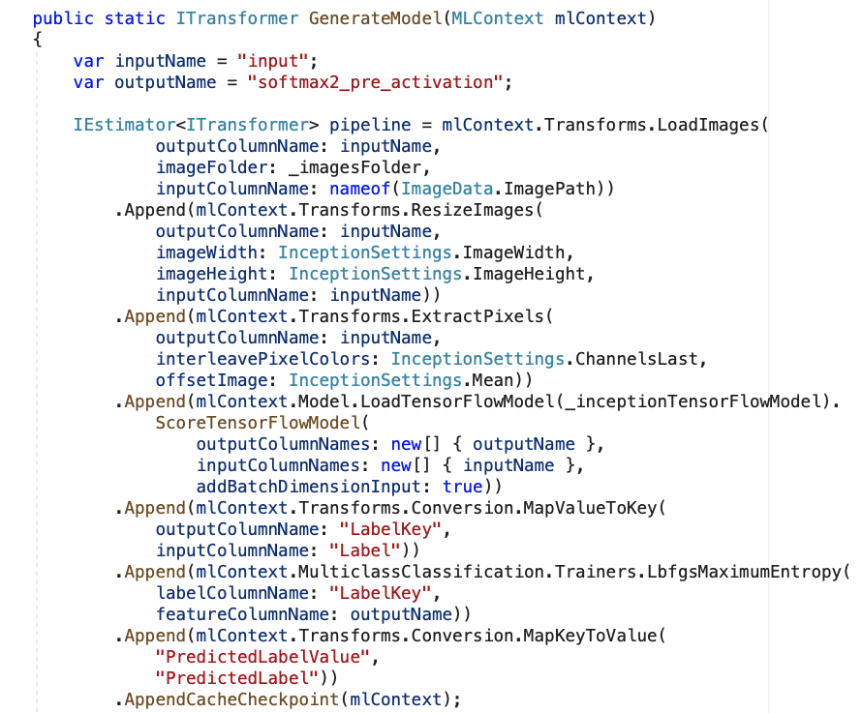
Build an ML .NET model pipeline
Notes:
An ML.NET model pipeline is a chain of estimators.
It creates a pipeline for the model, and trains the pipeline to produce the ML.NET model. It also evaluates the model against some previously unseen test data.
First parf: Add the estimators to load, resize and extract the pixels from the image data:
The image data needs to be processed into the format that the TensorFlow model expects. In this case, the images are loaded into memory, resized to a consistent size, and the pixels are extracted into a numeric vector.
Then we have Add the estimator to load the TensorFlow model, and score it:
This stage in the pipeline loads the TensorFlow model into memory, then processes the vector of pixel values through the TensorFlow model network. Applying inputs to a deep learning model, and generating an output using the model, is referred to as Scoring. When using the model in its entirety, scoring makes an inference, or prediction.
In this case, you use all of the TensorFlow model except the last layer, which is the layer that makes the inference. The output of the penultimate layer is labeled softmax_2_preactivation. The output of this layer is effectively a vector of features that characterize the original input images.
This feature vector generated by the TensorFlow model will be used as input to an ML.NET training algorithm.
Third: Add the estimator to map the string labels in the training data to integer key values:
The ML.NET trainer that is appended next requires its labels to be in key format rather than arbitrary strings. A key is a number that has a one to one mapping to a string value.
Add the ML.NET training algorithm:
Add the estimator to map the predicted key value back into a string:

Slide 21
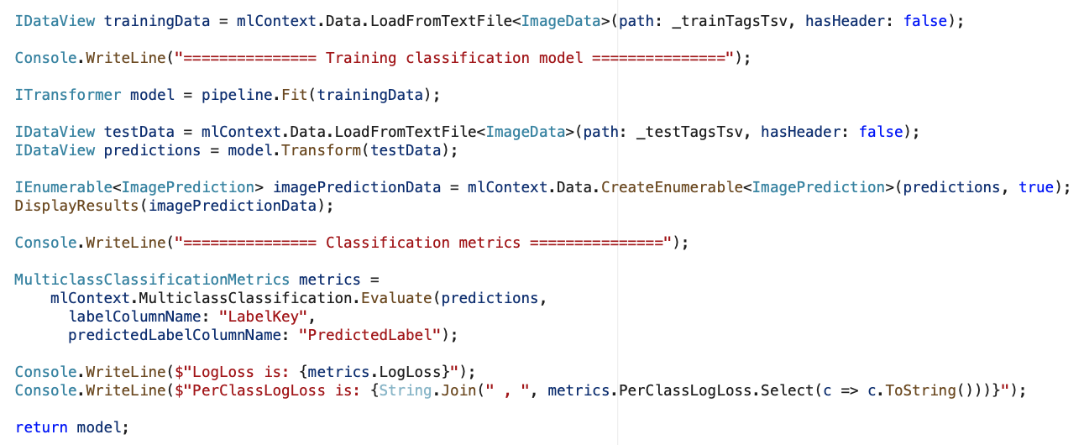
Train the model
Notes:
Data in ML.NET is represented as an IDataView class. IDataView is a flexible, efficient way of describing tabular data (numeric and text). Data can be loaded from a text file or in real time (for example, SQL database or log files) to an IDataView object.
The Fit() method trains your model by applying the training dataset to the pipeline.

Slide 22
Evaluate accuracy
Notes:
Load and transform the test data, by adding the following code to the next line of the GenerateModelmethod:
There are a few sample images that you can use to evaluate the model. Like the training data, these need to be loaded into an IDataView, so that they can be transformed by the model.
Once you have the prediction set, the Evaluate() method:
Assesses the model (compares the predicted values with the test dataset labels).
Returns the model performance metrics.
The following metrics are evaluated for image classification:
Log-loss - see Log Loss. You want Log-loss to be as close to zero as possible.
Per class Log-loss. You want per class Log-loss to be as close to zero as possible.

Slide 23
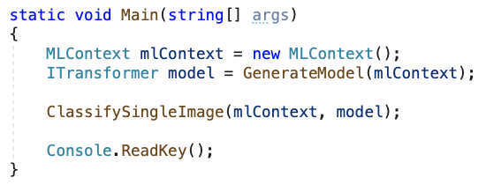
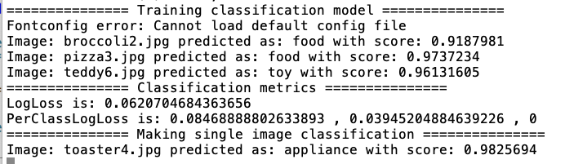
Run the app!

Slide 24
Why you should care about Transfer Learning?
Notes:
According to Andrew Ng, transfer learning will become a key driver of Machine Learning success in industry.

Slide 25


Slide 26
Thank you for your attention!
Luis Beltrán
luis@luisbeltran.mx
@darkicebeam

